Slide 1
6
Discounted Cash Flow Valuation
Prepared by Anne Inglis, Ryerson University
APS 1016 H Summer 2019
Notes:
5.<number>

Slide 2
Week 3 DCF analysis
University of Toronto. Financial management for engineers
APS 1016 H Summer 2019
6-<number>

Slide 3
Key Concepts and Skills
Be able to compute the future value and present value of multiple cash flows
APS 1016 H Summer 2019
6-<number>
Notes:
5.<number>

Slide 4
Chapter Outline
Future and Present Values of Multiple Cash Flows
Valuing Level Cash Flows: Annuities and Perpetuities
APS 1016 H Summer 2019
6-<number>
Notes:
5.<number>

Slide 5
Multiple Cash Flows 6.1 – FV Example 1
LO1
You currently have $7,000 in a bank account earning 8% interest. You think you will be able to deposit an additional $4,000 at the end of each of the next three years. How much will you have in three years?
APS 1016 H Summer 2019
6-<number>
Notes:
5.<number>

Slide 6
Multiple Cash Flows FV Example 1 continued
LO1
Find the value at year 3 of each cash flow and add them together.
  Formula Approach
    Today (year 0): FV = 7000(1.08)³ = 8,817.98
    Year 1: FV = 4,000(1.08)² = 4,665.60
    Year 2: FV = 4,000(1.08) = 4,320
    Year 3: value = 4,000
    Total value in 3 years = 8817.98 + 4665.60 + 4320 + 4000 = 21,803.58
APS 1016 H Summer 2019
6-<number>
Notes:
5.<number>

Slide 7
Multiple Cash Flows – PV Example 1
LO1
You are offered an investment that will pay you $200 in one year, $400 the next year, $600 the year after, and $800 at the end of the following year. You can earn 12% on similar investments. How much is this investment worth today?
APS 1016 H Summer 2019
6-<number>
Notes:
5.<number>

Slide 8
Multiple Cash Flows - PV Example 1 - Timeline
LO1
0
1
2
3
4
200
400
600
800
178.57
318.88
427.07
508.41
1432.93
APS 1016 H Summer 2019
6-<number>
Notes:
5.<number>

Slide 9
Multiple Cash Flows - PV Example 1 continued
LO1
Find the PV of each cash flow and add them
  Formula Approach
    Year 1 CF: 200 / (1.12)¹ = 178.57
    Year 2 CF: 400 / (1.12)² = 318.88
    Year 3 CF: 600 / (1.12)³ = 427.07
    Year 4 CF: 800 / (1.12)⁴ = 508.41
    Total PV = 178.57 + 318.88 + 427.07 + 508.41 = 1432.93
APS 1016 H Summer 2019
6-<number>
Notes:
5.<number>

Slide 10
Decisions, Decisions
LO1
Your broker calls you and tells you that he has this great investment opportunity. If you invest $100 today, you will receive $40 in one year and $75 in two years. If you require a 15% return on investments of this risk, should you take the investment?
  Use the CF keys to compute the value of the investment
    CF; CF₀ = 0; C01 = 40; F01 = 1; C02 = 75; F02 = 1
    NPV; I = 15; CPT NPV = 91.49
  No – the broker is charging more than you would be willing to pay.
APS 1016 H Summer 2019
6-<number>
Notes:
5.<number>
You can also use this as an introduction to NPV by having the students put –100 in for CF₀. When they compute the NPV, they will get –8.51. You can then discuss the NPV rule and point out that a negative NPV means that you do not earn your required return. You should also remind them that the sign convention on the regular TVM keys is NOT the same as getting a negative NPV.

Slide 11
Saving For Retirement
LO1
You are offered the opportunity to put some money away for retirement. You will receive five annual payments of $25,000 each beginning in 40 years. How much would you be willing to invest today if you desire an interest rate of 12%?
APS 1016 H Summer 2019
6-<number>
Notes:
5.<number>

Slide 12
Saving For Retirement Timeline
LO1
0 1 2 … 39 40 41 42 43 44
0 0 0 … 0 25K 25K 25K 25K 25K
Notice that the year 0 cash flow = 0 (CF₀ = 0)
The cash flows years 1 – 39 are 0 (C01 = 0; F01 = 39)
The cash flows years 40 – 44 are 25,000 (C02 = 25,000; F02 = 5)
APS 1016 H Summer 2019
6-<number>
Notes:
5.<number>

Slide 13
Annuities and Perpetuities 6.2
LO1
Annuity – finite series of equal payments that occur at regular intervals
  If the first payment occurs at the end of the period, it is called an ordinary annuity
  If the first payment occurs at the beginning of the period, it is called an annuity due
Perpetuity – infinite series of equal payments
APS 1016 H Summer 2019
6-<number>
Notes:
5.<number>

Slide 14
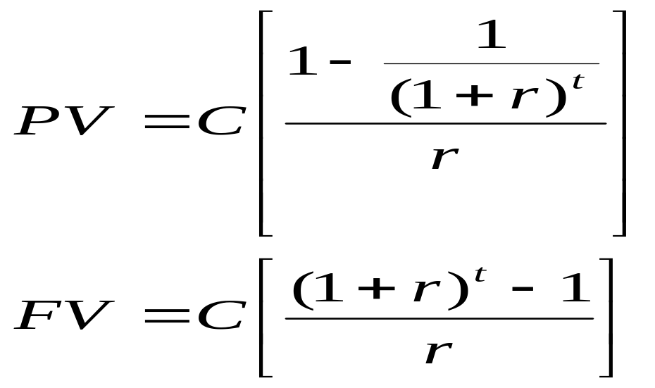
Annuities and Perpetuities – Basic Formulas
LO1
Perpetuity: PV = C / r
Annuities:
APS 1016 H Summer 2019
6-<number>
Notes:
5.<number>

Slide 15
Annuity – Example 1
LO1
After carefully going over your budget, you have determined that you can afford to pay $632 per month towards a new sports car. Your bank will lend to you at 1% per month for 48 months. How much can you borrow?
APS 1016 H Summer 2019
6-<number>
Notes:
5.<number>

Slide 16
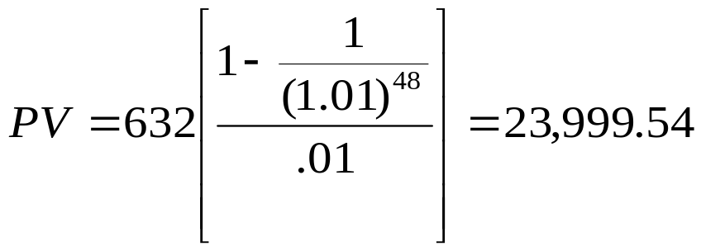
Annuity – Example 1 continued
LO1
You borrow money TODAY so you need to compute the present value.
Formula Approach
Calculator Approach
  48 N; 1 I/Y; -632 PMT; CPT PV = 23,999.54 ($24,000)
APS 1016 H Summer 2019
6-<number>
Notes:
5.<number>

Slide 17

Annuities on the Spreadsheet - Example
LO1
The present value and future value formulas in a spreadsheet include a place for annuity payments
Click on the Excel icon to see an example
APS 1016 H Summer 2019
6-<number>
Notes:
5.<number>

Slide 18
Finding the Payment
LO2
Suppose you want to borrow $20,000 for a new car. You can borrow at 8% per year, compounded monthly (8%/12 = 0.66667% per month). If you take a 4 year loan, what is your monthly payment?
  Formula Approach
    20,000 = C[1 – 1 / 1.0066667⁴⁸] / .0066667
    C = 488.26
  Calculator Approach
    4(12) = 48 N; 20,000 PV; .66667 I/Y; CPT PMT = 488.26
APS 1016 H Summer 2019
6-<number>
Notes:
5.<number>
Note if you do not round the monthly rate and actually use 8/12, then the payment will be 448.30

Slide 19
Finding the Payment on a Spreadsheet
LO2
Another TVM formula that can be found in a spreadsheet is the payment formula
  PMT(rate,nper,pv,fv)
  The same sign convention holds as for the PV and FV formulas
Click on the Excel icon for an example
APS 1016 H Summer 2019
6-<number>
Notes:
5.<number>

Slide 20
Finding the Number of Payments – Example 1
LO3
You ran a little short on your February vacation, so you put $1,000 on your credit card. You can only afford to make the minimum payment of $20 per month. The interest rate on the credit card is 1.5% per month. How long will you need to pay off the $1,000?
APS 1016 H Summer 2019
6-<number>
Notes:
5.<number>

Slide 21
Finding the Number of Payments – Example 1 continued
LO3
Formula Approach
  Start with the equation and remember your logs.
    1000 = 20(1 – 1/1.015^{t}) / .015
    .75 = 1 – 1 / 1.015^{t}
    1 / 1.015^{t} = .25
    1 / .25 = 1.015^{t}
    t = ln(1/.25) / ln(1.015) = 93.111 months = 7.76 years
Calculator Approach
  The sign convention matters!!!
    1.5 I/Y
    1000 PV
    -20 PMT
    CPT N = 93.111 MONTHS = 7.76 years
And this is only if you don’t charge anything more on the card!
APS 1016 H Summer 2019
6-<number>
Notes:
5.<number>
This is an excellent opportunity to talk about credit card debt and the problems that can develop if it is not handled properly. Many students don’t understand how it works and it is never discussed. Additionally, students seem to be a new target market for aggressive marketing practices of the credit card providers. This is something that students can take away from the class, even if they aren’t finance majors. An excellent discussion of this problem can be found in chapter 1 of Gordon Pape’s book “Get Control of Your Money”.

Slide 22
Finding the Rate On the Financial Calculator
LO2
Suppose you borrow $10,000 from your parents to buy a car. You agree to pay $207.58 per month for 60 months. What is the monthly interest rate?
  Calculator Approach
    Sign convention matters!!!
    60 N
    10,000 PV
    -207.58 PMT
    CPT I/Y = .75%
APS 1016 H Summer 2019
6-<number>
Notes:
5.<number>
The next slide talks about how to do this without a financial calculator.

Slide 23
Future Values for Annuities – Example 1
LO1
Suppose you begin saving for your retirement by depositing $2000 per year in an RRSP. If the interest rate is 7.5%, how much will you have in 40 years?
  Formula Approach
    FV = 2000(1.075⁴⁰ – 1)/.075 = 454,513.04
  Calculator Approach
    Remember the sign convention!!!
    40 N
    7.5 I/Y
    -2000 PMT
    CPT FV = 454,513.04
APS 1016 H Summer 2019
6-<number>
Notes:
5.<number>

Slide 24
Annuity Due – Example 1
LO1
You are saving for a new house and you put $10,000 per year in an account paying 8% compounded annually. The first payment is made today. How much will you have at the end of 3 years?
APS 1016 H Summer 2019
6-<number>
Notes:
5.<number>

Slide 25
Annuity Due – Example 1 Timeline
LO1
0 1 2 3
10000 10000 10000
32,464
35,061.12
APS 1016 H Summer 2019
6-<number>
Notes:
5.<number>
If you use the regular annuity formula, the FV will occur at the same time as the last payment. To get the value at the end of the third period, you have to take it forward one more period.

Slide 26
Annuity Due – Example 1 continued
LO1
  Formula Approach
    FV = 10,000[(1.08³ – 1) / .08](1.08) = 35,061.12
  Calculator Approach
    2nd BGN 2nd Set (you should see BGN in the display)
    3 N
    -10,000 PMT
    8 I/Y
    CPT FV = 35,061.12
    2nd BGN 2nd Set (be sure to change it back to an ordinary annuity)
APS 1016 H Summer 2019
6-<number>
Notes:
5.<number>
Note that the procedure for changing the calculator to an annuity due is similar on other calculators.
What if it were an ordinary annuity? FV = 32,464 (so receive an additional 2597.12 by starting to save today.)
Remind students to change their calculator back to the regular annuity setting before proceeding with other questions!

Slide 27
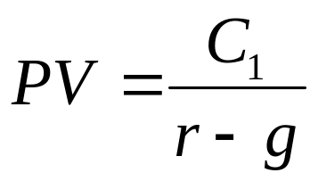
Growing Perpetuity
LO1
The perpetuities discussed so far have constant payments
Growing perpetuities have cash flows that grow at a constant rate and continue forever
Growing perpetuity formula:
6-<number>
Notes:
5.<number>

Slide 28
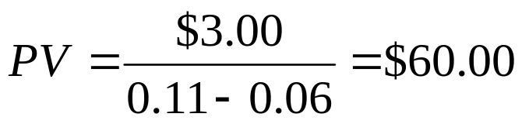
Growing Perpetuity – Example 1
LO1
Hoffstein Corporation is expected to pay a dividend of $3 per share next year. Investors anticipate that the annual dividend will rise by 6% per year forever. The required rate of return is 11%. What is the price of the stock today?
6-<number>
Notes:
5.<number>

